Slide 1
The Basics of Climate Change

Slide 2
What are global warming and climate change? How and why has climate changed in the past?
Learning objectives
Global warming vs climate change
Past climate change
Humans as part of the natural environment
Spatial understanding of climate change
To answer these questions, we will:
Explore the differences between global warming and climate change
Learn how temperature has changed over the last 5.3 million years
Investigate how humans are part of the natural environment

Slide 3
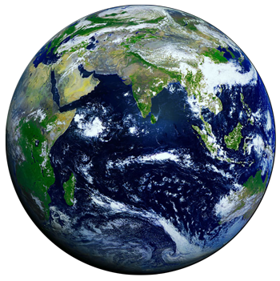

Global Warming vs Climate Change
Learning objectives
Global warming vs climate change
Past climate change
Humans as part of the natural environment
Spatial understanding of climate change
Global Warming
Overall increase in global temperature
Climate Change
Long term changes in precipitation, temperature, and wind patterns in a specific location
Notes:
However, what happens when that consistent pattern starts to change? This is where global warming and climate change come in.
Like weather and climate, global warming and climate change are often used interchangeably but are two separate ideas.
Global warming is the overall increase in average global temperature.
Climate change, on the other hand, is a change to the long-term patterns of precipitation, temperature, and wind in a specific place. Climate change is not experienced the same in all locations on Earth. Some locations will warm, while others will cool. Some locations will become wetter, while other locations will become drier.

Slide 4
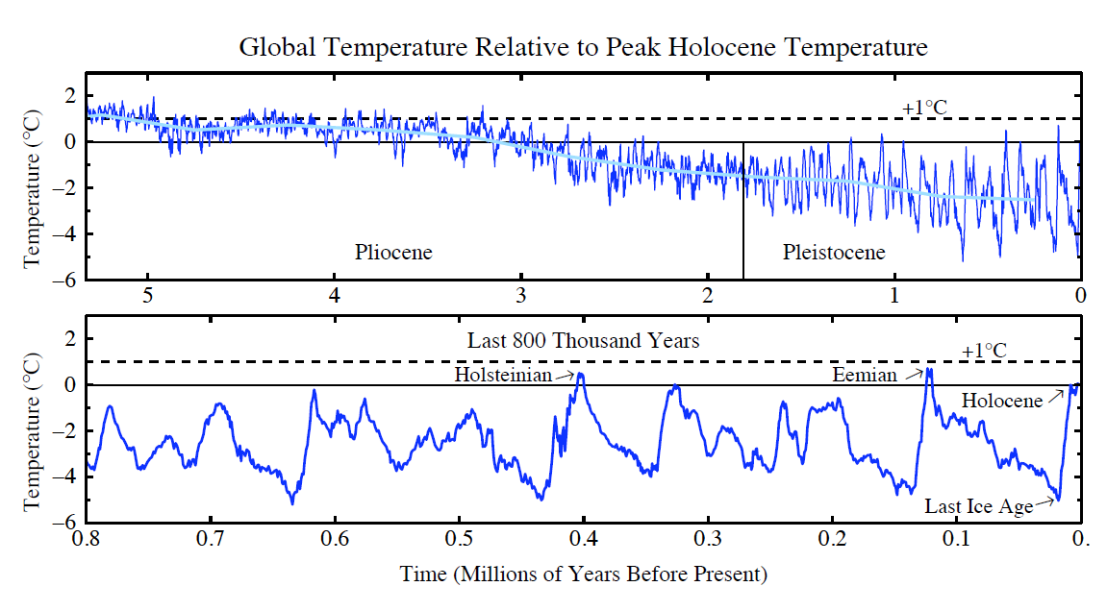
Past Climate Change
Learning objectives
Global warming vs climate change
Past climate change
Humans as part of the natural environment
Spatial understanding of climate change
Pliocene Epoch (5.3 – 2.58 million years ago)
Global cooling, likely because of movement of continents and changes in ocean currents
Pleistocene Epoch (2.58 million – 11,700 years ago)
Repeated glaciations, caused by changes to Earth’s tilt and revolution, tectonics, changes in greenhouse gas concentrations
Modified from Hansen and Sato. 2011. Science Briefs: Earth’s Climate History: Implication for Tomorrow. https://www.giss.nasa.gov/research/briefs/archive/2011_hansen_15/
Notes:
*Slide animated to highlight specific periods of time*
Climate has changed throughout time. This graph is showing the last 5.5 million years, including the Pliocene and Pleistocene epochs.

Slide 5
Past Climate Change
Learning objectives
Global warming vs climate change
Past climate change
Humans as part of the natural environment
Spatial understanding of climate change
End of Pleistocene
Likely caused by changes in Earth’s tilt, albedo and greenhouse gas concentrations
Holocene Epoch (11,700 years ago to present)
Modified from Hansen and Sato. 2011. Science Briefs: Earth’s Climate History: Implication for Tomorrow. https://www.giss.nasa.gov/research/briefs/archive/2011_hansen_15/
Notes:
*Slide animated to highlight specific periods of time*
Climate has changed throughout time. This graph is showing the last 5.5 million years, including the end of the Pleistocene and the Holocene – which we will talk about in more detail.

Slide 6
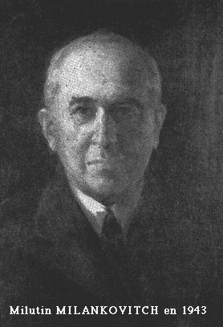
Climate at the Orbital Scale
Learning objectives
Global warming vs climate change
Past climate change
Humans as part of the natural environment
Spatial understanding of climate change
Milankovitch Cycles
Long term changes in earth’s orbital path, tilt, and wobble that increase or decrease seasonality
Notes:
*Slide animated to highlight specific periods of time*
Climate has changed throughout time. This graph is showing the last 5.5 million years, including the Pliocene and Pleistocene epochs.

Slide 7
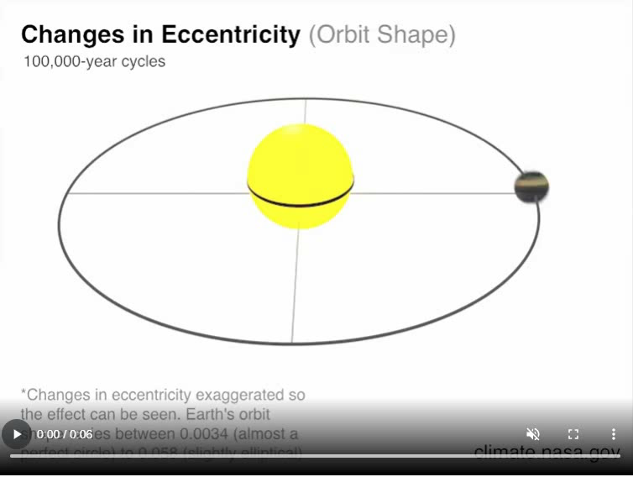
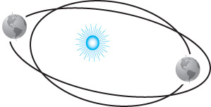
3 Milankovitch Cycles
Eccentricity – shape of the Earth’s orbit around the sun
Increases glaciations when the orbit is more elliptical
Notes:
*Slide animated to highlight specific periods of time*
Climate has changed throughout time. This graph is showing the last 5.5 million years, including the Pliocene and Pleistocene epochs.

Slide 8
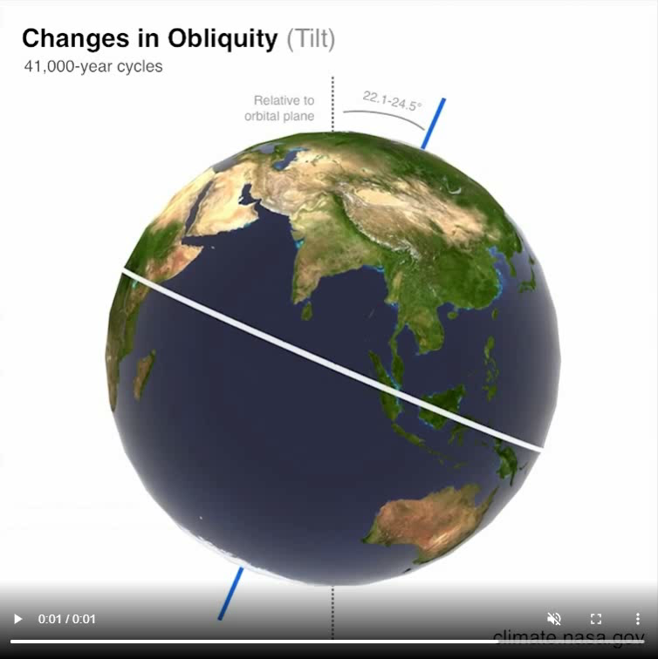
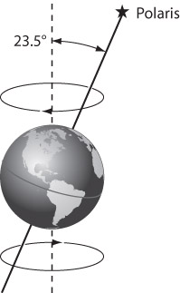
3 Milankovitch Cycles
Precession – Earth’s wobble as it spins on its own axis
Changes which way the north pole is facing
Affects when we have seasons
Notes:
*Slide animated to highlight specific periods of time*
Climate has changed throughout time. This graph is showing the last 5.5 million years, including the Pliocene and Pleistocene epochs.

Slide 9
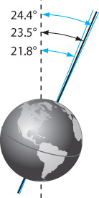
3 Milankovitch Cycles
Obliquity – change in the earth’s tilt
Shifts between 21.5° - 24.5°
Less tilt = less seasonality
More tilt = more seasonality
Can affect glaciations
Notes:
*Slide animated to highlight specific periods of time*
Climate has changed throughout time. This graph is showing the last 5.5 million years, including the Pliocene and Pleistocene epochs.

Slide 10
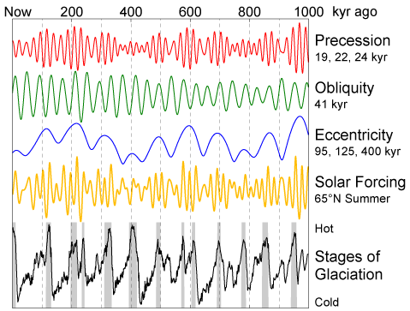
Milankovitch Cycles
Learning objectives
Global warming vs climate change
Past climate change
Humans as part of the natural environment
Spatial understanding of climate change
Gray bars = interglacial periods
Notes:
*Slide animated to highlight specific periods of time*
Climate has changed throughout time. This graph is showing the last 5.5 million years, including the Pliocene and Pleistocene epochs.

Slide 11
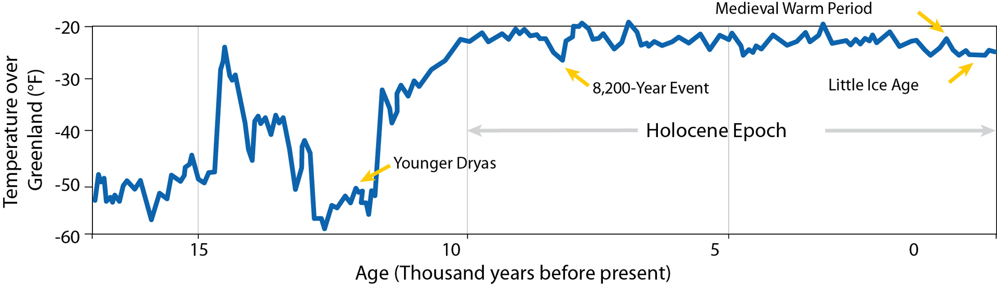
Past Climate Change
Learning objectives
Global warming vs climate change
Past climate change
Humans as part of the natural environment
Spatial understanding of climate change
Younger Dryas (12,900 to 11,700 years ago)
Rapid cooling
Likely caused by change in ocean circulation
Holocene (11,700 years ago to present)
Variable climates
Likely caused by changes in greenhouse gases, declining ice, changes in insolation patterns, and changes in ocean circulation
Last glacial
period
Image copyright National Oceanic and Atmospheric Administration (NOAA). https://www.climate.gov/media/4437
Notes:
*Slide animated to highlight specific periods of time*
Climate has changed throughout time. This graph is showing the temperature in Greenland as compared to present day.
As Earth began to come out of the last ice age, it experienced rapid cooling in an event called the Younger Dryas. This rapid cooling was likely caused by glacial meltwater freshening the northern Atlantic and changing ocean circulation patterns. This likely resulted in less heat being carried to the poles and thus a rapid cooling. [Firestone hypothesis?]
After the Younger Dryas, we entered the Holocene Epoch. This is a time of variable climates likely caused by a combination of changes in greenhouse gas concentrations, declining ice, changes in insolation patterns, and changes in ocean circulation at a more moderate scale than was experienced during the Younger Dryas.

Slide 12
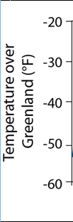
Humans as part of the natural environment
Learning objectives
Global warming vs climate change
Past climate change
Humans as part of the natural environment
Spatial understanding of climate change
8,200-Year Event
Abrupt cooling
Likely caused by decreased
greenhouse gases (GHGs) and change in ocean circulation
Medieval Warm Period (900–1300AD)
Warming temperatures
Likely caused by ocean circulation, increase insolation, and increased GHG’s from settlement
Little Ice Age (1300–1850 AD)
Cooling!
Likely caused by changes in ocean circulation, less sunspots, decrease in GHGs from loss of native populations and plague
Image copyright National Oceanic and Atmospheric Administration (NOAA). https://www.climate.gov/media/4437
Notes:
During the Holocene, there are a number of interesting climate events.
About 8,200 years ago, there was an abrupt cooling that likely resulted from a decrease in greenhouse gases and a change in ocean circulation.
From about 900-1300AD, climate began warming in an event called the Medieval Warm Period. While there are physical processes that contributed to this event, specifically strong ocean currents bringing heat from the tropics to the northern latitudes and an increase in solar radiation, humans were part of the natural environment and contributed to changes in climate. This was a time of settlement, especially in the Americas. Removing vegetation and burning lands (slash and burn) to create areas for agriculture and settlement produced GHGs and increased GHGs in the atmosphere.
Between 1300-1850AD, there were cooling temperatures. Physical processes, such as weakening of ocean circulation and less sunspots resulting in less solar energy reaching the earth, contributed to this cooling. Humans also contributed to this cooling. During settlement of the Americas, there was a massive loss of Native/Indigenous populations. Likewise, this was also when the bubonic plague was circulating. These loss of populations meant there was less expansion of settlement, less agriculture, and overall less burning, resulting in a decrease in greenhouse gas concentrations in the atmosphere.

Slide 13
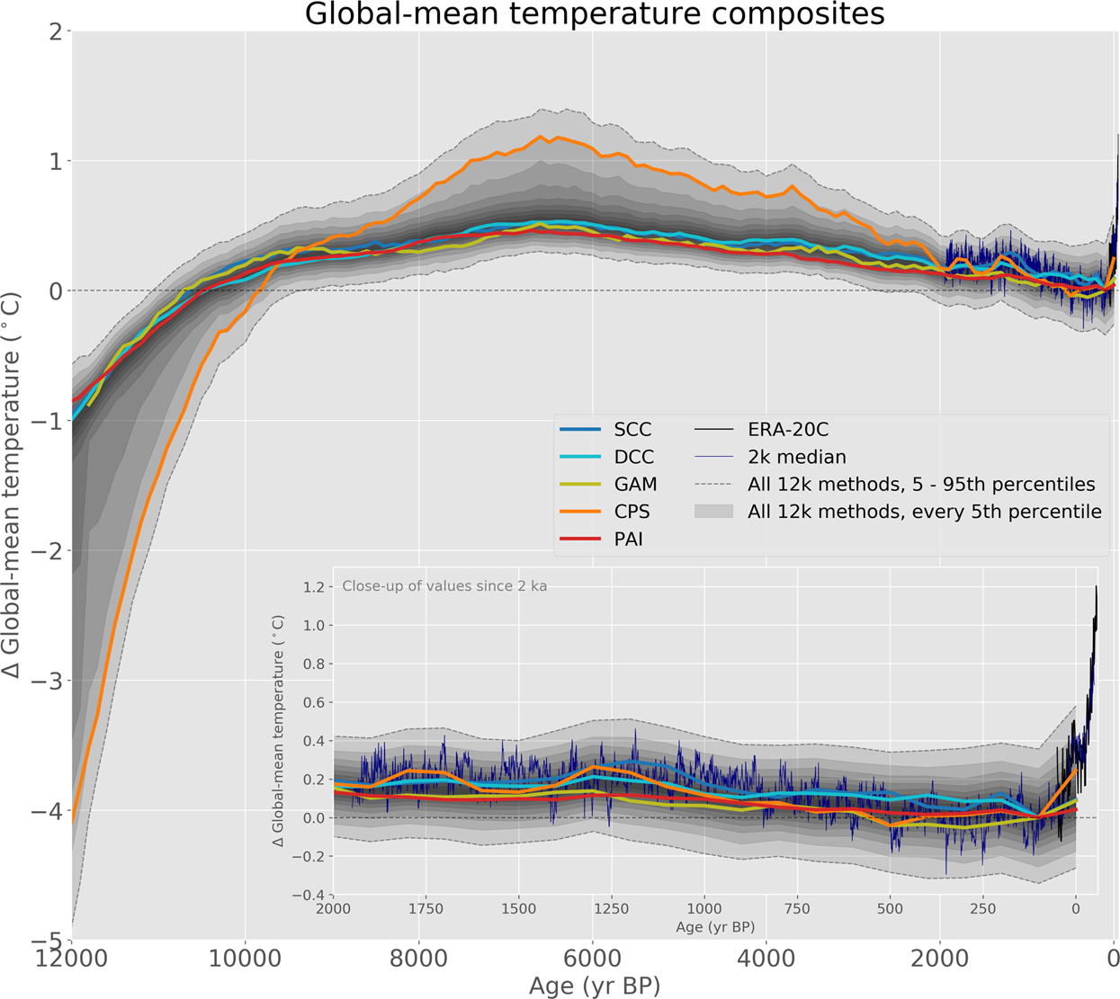
Present Day
Learning objectives
Global warming vs climate change
Past climate change
Humans as part of the natural environment
Spatial understanding of climate change
Since the Industrial Revolution, there has been a dramatic rise in temperatures at a rate not previous experienced during the Holocene
Image copyright Kaufman et al. 2020. Holocene global mean surface temperature, a multi-method reconstruction approach. Scientific Data, 7, 201.
Notes:
This graph is showing the Holocene. More towards present day, we see a dramatic rise in temperatures. This rise occurred at a rate that was much faster than previously experienced during the Holocene.

Slide 14
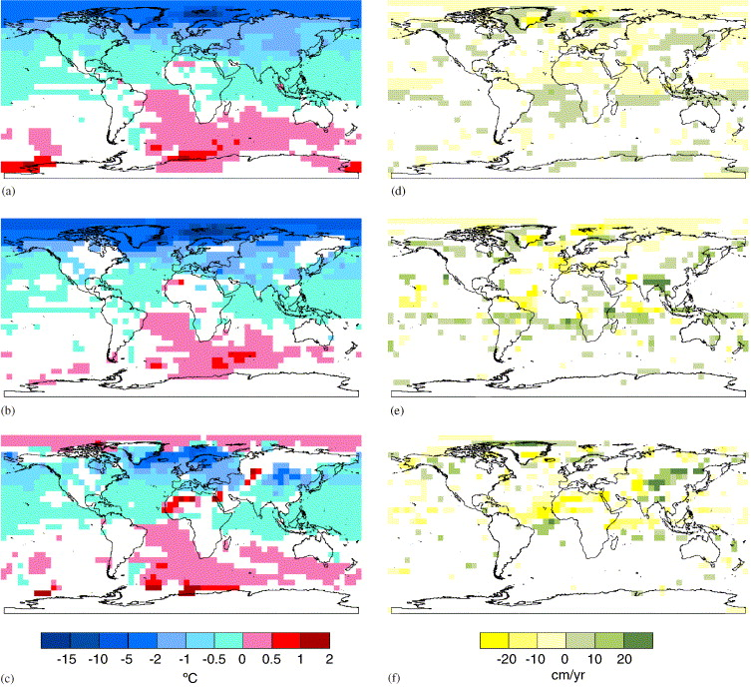
Spatial understanding of climate change
Learning objectives
Global warming vs climate change
Past climate change
Humans as part of the natural environment
Spatial understanding of climate change
Climate doesn’t change evenly across the Earth
Some areas will warm while others cool
Some areas will become wetter while others become drier
Latitude, altitude, atmospheric instability, winds, rain shadows, proximity to water, land cover, and other factors affect how climate changes!
Annual
January
July
8,200-Year Event temperature (left) and precipitation (right) anomalies
A.P. Wiersma, H. Renssen. 2006. Model–data comparison for the 8.2kaBP event: confirmation of a forcing mechanism by catastrophic drainage of Laurentide Lakes, Quaternary Science Reviews, Volume 25, Issues 1–2(63-88), https://doi.org/10.1016/j.quascirev.2005.07.009
Notes:
As mentioned, climate doesn’t change evenly across the Earth. The 8.2kyr Event is a good example of this. While there was rapid cooling during this time, the cooling mostly occurred in the northern hemisphere, as is seen by the blue in the northern hemisphere on the left images. The southern hemisphere and the north pole in the summer all warmed significantly. Likewise, the images on the right indicate precipitation anomalies with green representing more precipitation and yellow representing less. You can see there is no specific pattern that we can assign for the planet as a whole.
All of the factors that form different climates, such as latitude, altitude, instability, winds, rain shadows, proximity to water, and land cover all play into how climate will change in any given location.

Slide 15
What are global warming and climate change?
Learning objectives
Global warming vs climate change
Past climate change
Humans as part of the natural environment
Spatial understanding of climate change
Climate is the long-term patterns of atmospheric factors, such as temperature and precipitation
Global warming refers to warming of the entire earth, whereas climate change refers how various climates change over time at a specific location
How and why has climate changed in the past?
Climate has warmed and cooled in the past because of both natural and human causes, including changes in Earth’s orbital cycles, ocean circulation, changes in the amount of greenhouse gases, and settlement of humans
Temperatures have rapidly risen since the Industrial Revolution at a rate much faster than previously experienced during the Holocene
Climate does not change evenly across the earth

Slide 16
Discussion Prompts
What is the difference between global warming and climate change?
In detail, describe how temperature has changed over the past 5.3 million years.
In what ways have humans affected Earth’s climate in the past?
Based on what happened in the past, what do you think will happen to climate in the future?
Will these changes be uniform across the Earth?

